Slide 1
ConnectBud
Python
Class 5
By: Rahul Joshi

Slide 2
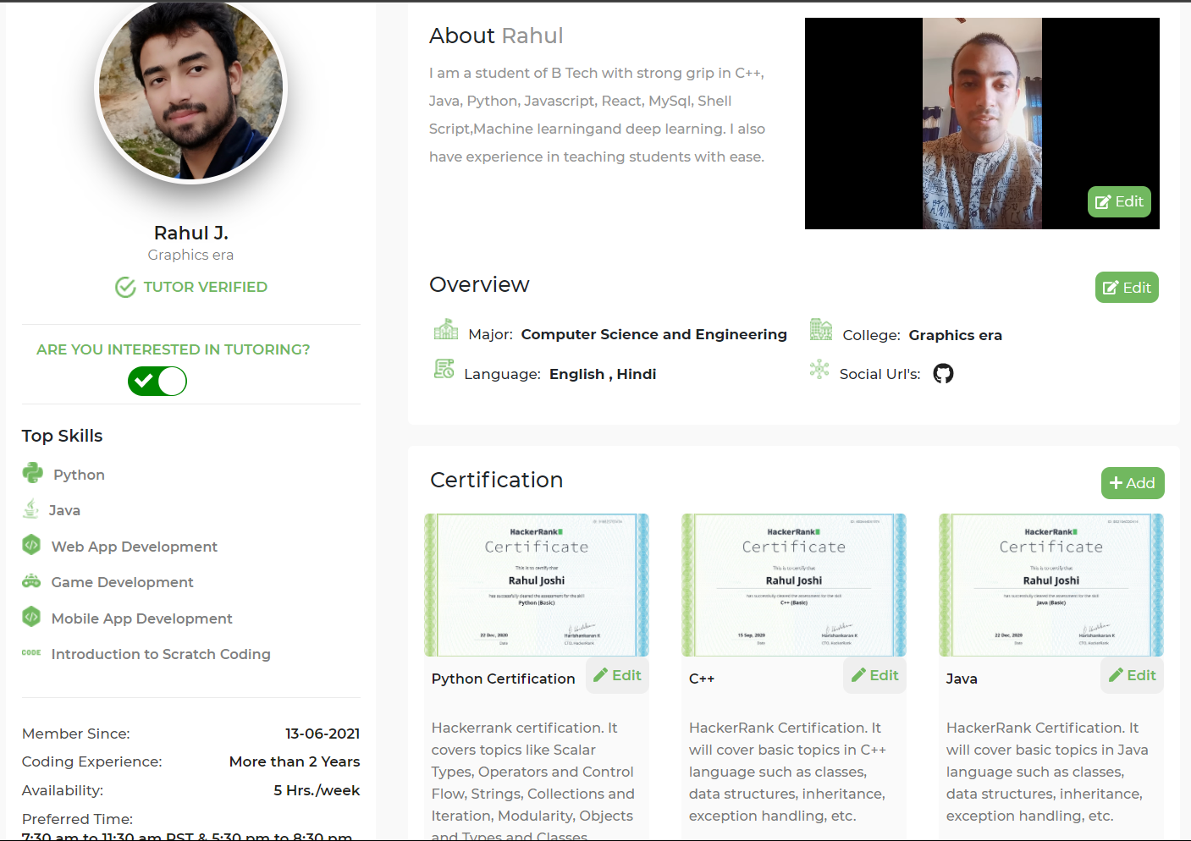

Slide 3
Class Overview
Class 5: • Conditional Statements

Slide 4
Day 5 H.W.
num=int(float(input("Age")))
print(num)
print(type(num))
flt=89.64
integr=int(flt)
integr2=57
flt2=float(integr2)
print(integr)
print(flt2)
age=int(input("Insert the age"))
print("Age : ",age)
print(type(age))
percentage=float(input("Insert the percentage"))
print("Percentage : ",percentage)
print(type(percentage))

Slide 5
Condition
Sunny / Rainy
Sunny
Rainy
Wear a t shirt
Wear a raincoat

Slide 6
Syntax
If( condition) :
Task
If weather=sunny:
wear a t-shirt
If weather=rainy:
wear a raincoat

Slide 7
Example
age=int(float(input("Enter your age")))
if age>18:
print("Above 18")
if age<18:
print("Below 18")
name=input("insert your name")
if name=="rahul":
print("Hello Rahul")
if name=="arav":
print("Hello Arav")
prc=float(input("Enter your percentage"))
if prc>90:
print("A+")
if prc>=35:
print("pass")
if prc<35:
print("fail")

Slide 8
Syntax
If( condition) :
Task
Else :
remaining task

Slide 9
Example
age=int(float(input("Age=")))
if age>15:
print("Above 15")
if age==18:
print(“18”)
else:
print("Below 18")

Slide 10
Task
Insert all the credentials of a user and compare for all the values inserted i.e name, age, percentage if all the conditions are true then say welcome
Otherwise say sorry you are not the user. If the conditions are true:
take the 4 ages(either as a float or int) and then calculate the sum.

Slide 11
End
For any queries: Contact:
Rahul Joshi rj26280218@gmail.com

